Slide 1
The Equality and Anti-Discrimination Ombud

Slide 2
Structure and organisation
The Ombud – established 1 January 2006
Integrates three former offices
An Independent public administrative agency
Subordinate to the Ministry of Children and Equality Affairs
Free from instruction from the Ministry
the Equality and Anti-discrimination Tribunal

Slide 3
Roles and tasks
The Ombud upholds the law and promote equality in all areas of society:
Gives “opinions” on complaint cases (subject to appeal), hence not “decisions”
Provides information – legal rights and responsibilities
Surveys and identifies trends – resp. for influencing society and government
Provides employers with information/guidance
Serves as a Forum and information centre

Slide 4
Legislation and structure
Gender Equality Act 1978, 2013
Anti-discrimination Act 2005, 2013
Discrimination and Accessibility Act 2008, 2013
Discrimination Law on Sexual Orientation (gender expression and gender identity) 2013
Other legislation
Labour Environment Act (political opinion, labour unions, age, sexual orientation)
Housing legislation (sexual orientation)
CEDAW, CERD and CRPD
Anti-discrimination Ombud Act
Structure and organisation, Roles and tasks

Slide 5
The Equality and Anti-Discrimination Tribunal
Administrativ body
Makes legally binding decisions in individual cases
Orders measures to prevent and rectify discriminatory conditions
Issues coercive fines

Slide 6
History
It all started with the Gender Equality Act of 1979
Purpose: Promote gender equality
The Gender Equality Ombud was established at the same time to enforce the Act
Creation of The Equality and Anti-Discrimination Ombud 2006, Anti- Discrimination Act plus housing laws. DTL 2009
Fragmented legislation
New anti-discrimination Acts of 2013.Harmonizing purpose

Slide 7
The Gender Equality Act
Incorporation of CEDAW
Main elements:
Direct and indirect differential treatment
Affirmative actions
Equal payment for work of equal value
Equal right to education
Harassment
Shared burden of proof
Duty to promote Gender equality
Duty to report (annually) on status and measures

Slide 8
Scope
General nature – covers all sectors
Exceptions:
Not to be enforced in the sphere of family life and personal matters
Removal of previous exception for religious communities*
Notes:
* Reflects a sharpening of demands made to religious communities. Cf samfundets skoler

Slide 9
General Clause
Direct discrimination
Unequal treatment of men and women due to the fact they are of a different sex
Unequal treatment due to pregnancy or use of parental rights awarded each sex in connection with childbirth, past assumed, future and by association
Indirect discrimination:
Unequal treatment of full-time and part-time employees
Unequal treatment in connection with use of extended parental leave

Slide 10
Affirmative Action
Different treatment may promote gender equality
Affirmative action in favour of women
Quotas/ radical affirmative action (purely based on gender) is illegal, but mild affirmative action is permissible
Affirmative action in favour of men
Mild affirmative action permissible but exclusively connected with child care/teaching professions

Slide 11
Public appointments: Representation in public committees etc
When a public body appoints or elects committees, etc., with four or more members, each sex must be represented by at least 40 per cent of the members.
2- 3persons: both sexes
4-5 persons: 2x each sex
6-8 persons: 3x each sex

Slide 12
Gender Equality in employment
Gender neutral job listings – unless obvious reasons
Actors and models
Patient care
Equal treatment in employment, promotion, dismissal
Questions during job-interview
Opportunities to pursue further education while in employment
Criteria for dismissal

Slide 13
Equal Pay
Identical jobs or jobs of equal value (irrespective of collective bargainings)
Relevent evaluation criteria:
Education
Skills and experience
Responsibility
Working condition etc
Example: a nurse and a doctor each functioning as an administrative manager in the same hospital

Slide 14
Equal right to Education
Men and women have an equal right to education
Employers shall treat women and men equally with regard to training, further education and leave of absence in connection with education etc.

Slide 15
Gender based and sexual harassment and further prohibitions
No person may subject another person to gender based or sexual harassment
(Employers/public and educational institutions are responsible for preventing and seeking to preclude the occurence of harassment - Related to duty to promote gender equality)
Prohibition against instruction, retaliation, contribution to discriminate

Slide 16
Liability for Damages
Responsibility regardless of fault
Damages may be awarded only by a court of law

Slide 17
Duty to promote gender equality
Public authorities, educational institutions
Employer
Active, targeted and systematic efforts
Account of status and measures in annual report
Educational institutions and teaching material
The Ombud monitors

Slide 18
The Anti-Discrimination Act
Incorporation of CERD
Purpose:
Fighting ethnic discrimination and promoting ethnic equality
Discriminatory grounds:
Ethnicity, nationality, language, skin colour, religion

Slide 19
The Anti-Discrimination Act
Main elements:
Applies to all areas of society *, except private sphere
*Employment &working environment, health & social benefits, housing, police matters, bars & discotheques, consumption, immigration

Slide 20
Anti-Discrimination Act cont’d
Main elements (cont.):
Prohibition against
direct and indirect discrimination
harassment
Instructions for discrimination or retaliation
Employers seeking information regarding employee´s religious or cultural opinion
Retaliation
Serious breach made in view of others (minimum two persons) may be subject to penal fine or 3 years max.prison

Slide 21
The Anti-Discrimination Act
Main elements (cont.):
Effective sanctions*:
Damages and compensation
imprisonment up to 3 years for serious breaches
* Coercive fines and injunctive measures may also be ordered in accordance with the Antidiscrimination Ombud Act which regulates the Ombud and the Tribunal´smandate

Slide 22
The Anti-discrimination and Accessibility Act (2009)
Three main provisions
§4: A prohibition to discriminate on the grounds of disability – directly and indirectly
§9: A duty for businesses open to the public to ensure universal design of their business’ main tasks, to secure accessibility for as many people as possible - physical environment, IT
§12: a duty placed upon employers, schools, councils providing child care and health services, to adapt the services to individually accomodate persons with disabilities

Slide 23
Ombud case law: Anti-discrimination and Accessibility Act
Discrimination directly or indirectly due to inaccessible services – bank services on the internet, payment options, air travel etc.
Passed over in process of recruitment
Health requirements for certain jobs
Employer’s duty to individually adapt tasks to employee with disability – ADHD, epilepsy etc.
Universal design of businesses

Slide 24
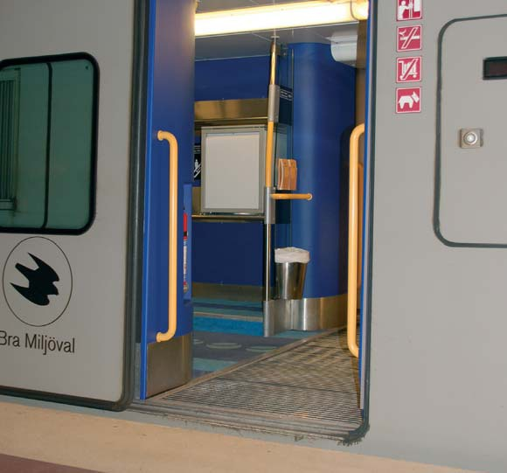
Anti-Discrimination and Accessibility Act (DTL)

Slide 25
Discrimination Law on Sexual Orientation
Sexual orientation (before covered under Employment Environmentt Act)
Gender identity* (before covered by Gender Equality Act) and gender expression, construed as one discrimination ground.
Notes:
New Act on change of legal gender 2016. admininistered by ministry of health

Slide 26
What and who is protected?
The fact that one has a love or sexual preference for a person of a specific gender (much more than purely sexual approach.
No need to have an established sexual identity such as homesexual, lesbian or bisexual. Heterosexuals are also covered.
Sexual practice preferences are not protected (fetichism, etc)
Gender identity self defined and covers several groups: transsexuals/ transgender,transvestites, inter-sex persons,(without limitation).

Slide 27
Protection grounds
Visible and based on the fact that one does not «fit»
Based on the knowledge of gender correctional treatment
Gender expression/ identity can apply in lieu of sexual orientation
The problems that stem from the heteronormal framework (concepts, typical expressions like «coming out of the closet»

Slide 28
Prohibitions and duties
Direct and indirect discrimination
Harassment, instruction, retaliation, participation
Public and social institutions’ duty to act
Educational institutions’ duty to prevent harassment
Employers employing over 50 employees and public sector employers duty to act , including wages, promotion, prevention against harassment. Duty to report in annual statement.
A weakness? No duty to accomodate (schools)*. Is duty to prevent harassment sufficient?
Notes:
*bathrooms, changing and shower rooms. Example vestkantbadet

Slide 29
Challenges
Different challenges for different groups
Minoriteies within groups: transgender with both sexes, without determined sex, plus variations. Intersex children operated at early stage. Continuing treatment, must be adapted. Indirect discrimination.
Sterilization required for sex change operation. Direct discrimination

Slide 30
Examples of cases/questions Gender Identity
Transexual person not entitled to tax credit for change of sex operation undergone abroad
Harassment
Sterelization required for sex- change operation
Lack of accomodation at school for 13 year old transgender pupil

Slide 31
Common rules for Burden of Proof
Plaintiff must show presumption: «reasons to believe» that different treatment has occurred
Respondent must rebut

Slide 32
Thank you
The Equality and
Anti-Discrimination Ombud
Telephone: +47 24 05 59 50
E-mail: post@ldo.no
Internet: www.ldo.no

