Slide 1
The School – An Arena for Promoting Gender Equality
Taran Knudstad, LDO. April 5th 2017

Slide 2
VAWG and hate speech– obstacles to GE
I will focus on:
Sexual harassment among young people
Other forms of sexual violence
Digital (sexual) violence against GW
Hate speech against girls and women

Slide 3
Hate Speech against women and girls
Threats and violence
Incitement to gender violence
Celebration of gender violence
Sexual and gender harassment
Glorification of sexual denigration of women in pornography
Glorification of denigration of women in games
Morality policing / hierarchy policing
Stigmatization
Sexist rhetoric based on prejudice and stereotype

Slide 4
Digital VAWG includes acts such as:
Hate speech
Digital stalking
Collective harassment and threats (online gamers)
Creep shots
Non-consensual digital spreading of private pictures
Disemmination of such pictures on male forums
Notes:
Bruker ikke tid på hva seksuell trakassering og voldtekt er – men spesifiserer hva ICT&VAWG er

Slide 5
Girls and young women part. volnurable
Higher prevalence
School an important arena; much takes place here
What starts outside school continues in school
What starts in school continues outside school (social media)
Notes:
This is the definiton that is stated in the gender equality act.
The Ombudsman do not enforce the pohibition of sexual harassment

Slide 6
School as an arena for VAG
Particular for Norway: upper secondary graduation celebration (songs, paraphernalia, «rape-cultures», extensive sexual harassment)
Buddy systems for new students
Closed internet forums hosted by male students
Notes:
I TILLEGG: Her om seksualisering generelt og overgrepskulturer blant unge

Slide 7
What can schools do?
The ombud’s recommendations – hate speech:
should be a topic in teaching that includes issues of democracy, equality and the use of digital media (i.e use the education system’s own knowledge objectives)
include work against hate speech into existing bullying programs
strengthen services provided to schools (such as the Dembra project)
Include hate speech as topic in vocational training/education
Notes:
Vis rapporten vår.

Slide 8
Physical sexual violence
Establish a low-threshold service for sexual harassment cases
Develop national minimum standards for sex education in primary and secondary school that address topics and knowledge objectives that reflect developments in society
Notes:
Her kan jeg snakke rundt om dagens undervisning som utdatert og at også lærere er enig i dette.

Slide 9
Digital violence against w & g
Again, better more updated sex ed:
Particular focus on the role of social media
Increase knowledge about different forms of digital violence, harassment and abuse
Also:
Strengthen school health services on all forms of VAWG; knowledge + capacity
Introduce compulsory education on digital violence in vocational training

Slide 11
These Social Harms of Hate Speech are Not Discussed
These harms are not on the agenda of political parties
They are not addressed in present nor previous Government action plans
Why Not?

Slide 12
The Debate about Freedom of Expression Has Blinded Us
When the topic of hate speech is discussed the focus always gets directed to a debate on restrictions or no restrictions on the freedom of expression
This has blinded us to the social harms of hate speech and other types of measures that could be taken to counteract such harms

Slide 13
Undue Reliance Upon the «Troll will Disintegrate» Belief
Hate speech should as far as possible be countered by the undesirable speech being expressed and reacted to in the public sphere.
Hate speech will, when expressed, be aired, cleaned and made decent through discussion and criticism.

Slide 14
Is there any evidence that the Troll will Disintegrate in the sun?
There is nothing to suggest that there is any truth to the proposition that hate speech, when uttered, gets cleansed and made decent through discussion and criticism.
No research supports this!
Today: more attention on radicalization (and a little bit on hate crime) but very limited efforts to combat lawful hate speech, indluding gbhs

Slide 15
National strategies to Counter the Social Harm of Hate Speech
Focus on hate speech and prejudice in school curriculum and course materials (root causes)
Allocate monies to research on the prevalence and social harms of hate speech (so as to make the harms visible) and mechanisms to reduce harms
Allocate monies to research on media self-regulation, eg. use of moderators, full-name policies,
Notes:
A comprehensive action plan

Slide 16
National strategies to Counter the Social Harm of Hate Speech (# 2)
The legal duty on public authorities to actively promote equality in their roles as policy-makers and service-providers, should include addressing prejudice, stigmatization and stereotypes
(promoting good relations between social groups)
Initiate campaigns of awareness to counter hate speech and promote responsibility in expression
Support economically civil society’s work against hate speech.

Slide 17
CSW event on lawful gbhs online
Increased knowledge about the ombud’s work with lawful gbhs, both nationally and internationally
To bring together activists, representatives of local and national authorities and academia
To expand our international network in an effort to further our work nationally

Slide 18
Cyber-harassment
Technology creates new spaces and venues for (sexual) harrasment of women and girls
It reaches you in your private home and everywhere else
It is difficult to curb/control
It reaches thousands and often involved more than one person= communities

Slide 19
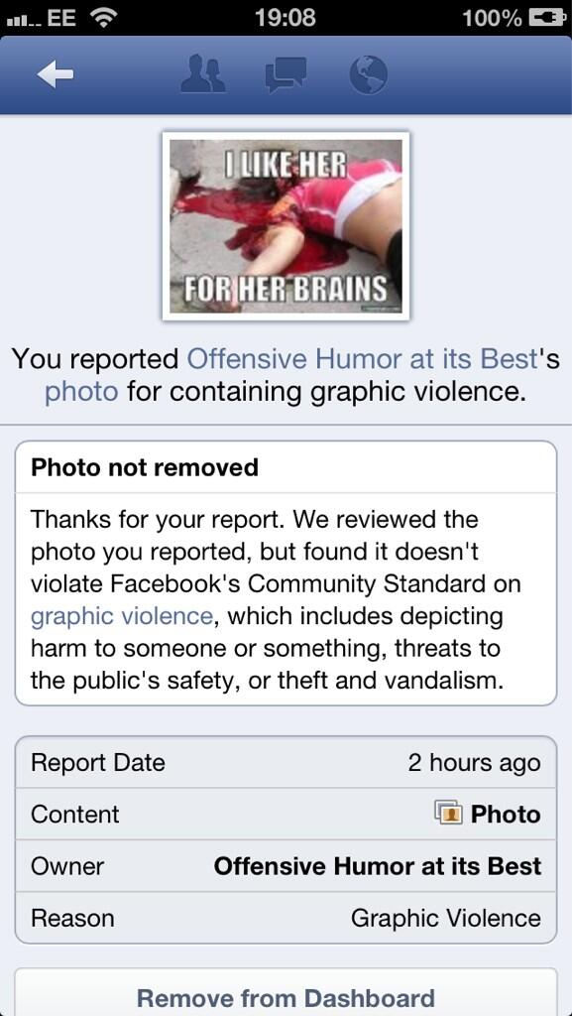
Notes:
Bilder samlet av WAM - Women Action Media Collective
Kampanje for å få Facebook til å fjerne hate speech som ble lastet opp – her ser man deres typisk svar ved klager på opplastede bilder

Slide 21
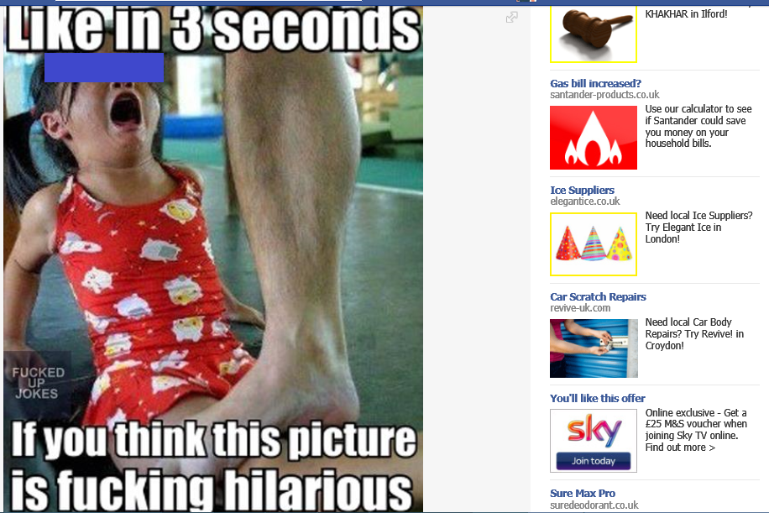

Slide 23
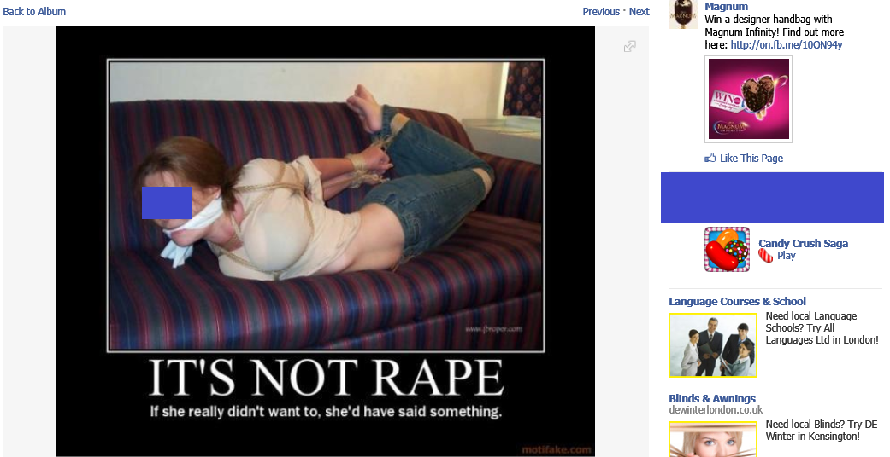

Slide 25
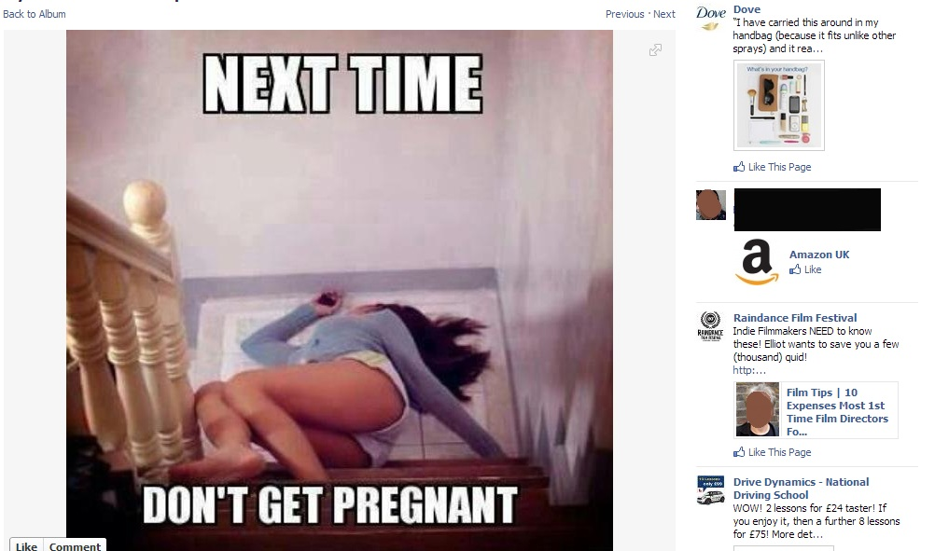

Slide 28
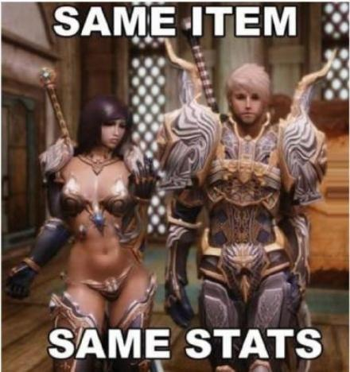

Slide 29
Notes:
Jamia Wilson, Women, Action and the Media

Slide 30
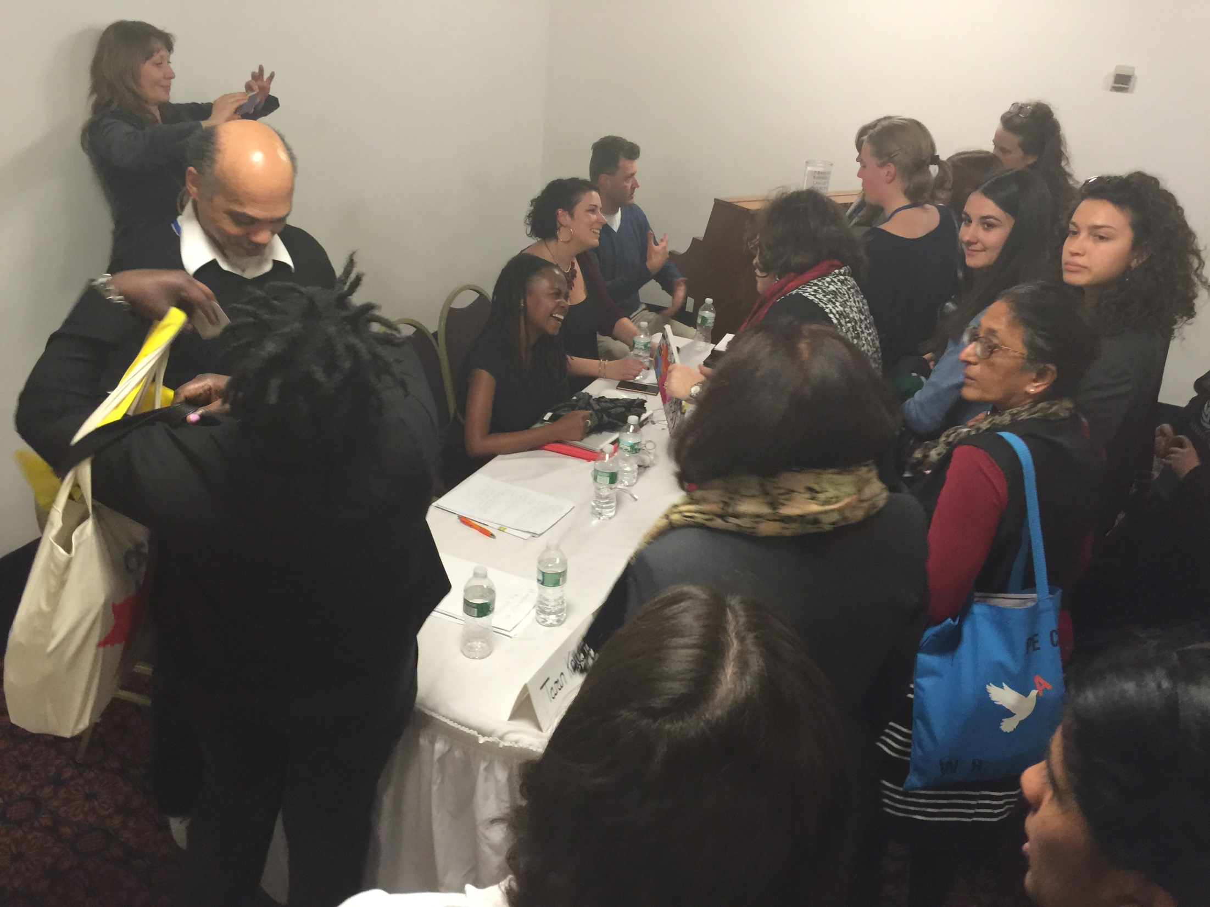

Slide 31
What we achieved
Praise from young people!
Political recognition and attention
Expanded network of valuable expertise
Increased collaboration with other organisations internationally

Slide 32
Follow-up conference
With the growth of social media and the internet, we are witnessing a renaissance of misogyny and digital havens for those who hate and harass women and girls.
How can we best increase our knowledge and understanding of the causes, consequences and mechanisms of such hate speech and how do we best combat it?

Slide 33
Issues to be addressed include:
What is hate? Hate as a social and cultural phenomenon
John Shuford, Ph.D. Director, Gonzaga University Institute for Hate Studies
Gender-based hate speech in online games and among gamers
Kristine Ask, Assistant Professor. Norwegian University of Science and Technology
Combatting gender-based hate speech on Facebook; the importance of activism
Jamia Wilson, Executive Director of Women, Action, and the Media
Gender-based hate speech – a threat to democracy
Aina Landsverk Hagen, researcher , Oslo and Akershus University college of applied sciences

Slide 34
Increased focus on VAW & ICT
Collaboration with Association for Progressive Communications
CEDAW as are primary advocacy tool
Normative gaps
And how to close them
Notes:
Nothing in the convention and nothing in GR #19

